Slide 1


Slide 2
Reasons to have a Hall of Fame
Celebrate your Athletic program
Honor the past success of programs
Inform students & community about the programs history
Promote school strength & unity
Reconnect alumni with school/program

Slide 3
Hall of Fame Checklist
Vision
Hall of Fame Committee
Budget
Information Gathering
Who can be honored
Nomination process
Selection
Publicity
Plaques & Gifts
Potential Challenges

Slide 4

Vision
Keep the “End in Mind”
What will the end result look like?
  Options:
    Catered Banquet
    Dessert Night
    Half-time of game
    On or Off campus
    Fundraiser
    Professional dress
Celebration of athletics in our community
How often will it occur
Realistic timeline

Slide 5
Selection of Hall of Fame Committee
Develop by-laws & guidelines of HOF program
  Establish your HOF committee
Selection of committee – potential members
  Faculty/administration, alumni, coaches, booster board members & community members
Athletic Director & Booster President (or designee)
  Continuing members to provide continuity

Slide 6
Hall of Fame Committee
Committee Membership
  A Hall of Fame committee will determine which candidates are selected to the HOF. The committee shall be comprised of the following members:
The Athletic Director, who shall serve as a standing Board Member and will appoint a Chairperson
Building Administrator
Retired or former Administrator
Athletic Booster Club Member
Current athletic coaches (male and female coach voted on by peers)
Retired or former athletic coach
Current faculty member
Retired or former faculty member
Local business owner/community leader

Slide 7
Hall of Fame Committee
Term
  All Board Members shall be appointed by the Athletic Director and or Principal, and shall serve for a two year term initially. At any time there shall be no fewer than 5 members and no more than 12 members.
  All members may be re-appointed for 2 year terms by the Athletic Director and or Principal at the conclusion of their initial term; However, the Athletic Director and or Principal may appoint new members at his/her discretion.
Dynamics of Committee
  As the AD I would suggest you ensure that you are able to manage the group. Just like your booster club – you want to be able to have conversations with members to ensure the rules and regulations are being followed. Selection of a Chair is key.

Slide 8
Budget
Things to consider for the budget
Ceremony
  At school or place in the community
  Food and drinks – will you provide dinner?
  Guest speaker
Plaques
  For the wall of fame at school and for the receipient
Gifts
  Any special gifts to inductees or family
Publicity
  Will you pay to advertise or attempt to reach larger number of people

Slide 9
Information Gathering
Research
  Annuals
  Old programs
  Newspaper articles
  Books
  Historical society
  Community members
  Bottom line – Get it Right!!!!

Slide 11
Who can be Honored
Develop solid criteria to support integrity of program
  Members of HOF committee not eligible (conflict of interest)
Categories
  Athletes
  Coaches
  Administrators
  Contributors

Slide 12
Who can be Honored
Membership is open to all athletes who were at Park View HS the first 15 years of the school's existence (1976-1991), in good standing or in special circumstances as determined by the Board Members
Membership is also open to coaches or administrators, who must have participated with distinction and/or made significant contributions to athletics at Park View High School. Such coaches or administrators shall be eligible for membership beginning five years after they have left Park View High School for any reason, or in special circumstances as determined by the Board Members.
As determined by the Board Members, Contributors will also be considered for nomination based upon their service and dedication to the athletic programs at Park View High School.

Slide 13
Nomination Process
A candidate may be nominated for Hall of Fame membership by any member of the community. Formal nomination shall be made using the form prescribed for such purpose and made available to the public.
All nomination packets must be received by the athletic department by March 1st of the nominating year, in order to be considered for induction into the fall class.
Once presented as an eligible nominee, a candidate who is not elected shall automatically be reconsidered annually until he/she has been considered for five years. Thereafter, re-nomination may occur at any time. The Chairman will notify any nominators if their nominee was not selected.

Slide 14


Slide 16

Selection of HOF Inductees
The Board Members shall meet at a time determined by the Chairman in order to nominate, review, and elect candidates. Each Board Member shall have one vote and all votes shall carry equal weight. In order to gain election, a candidate is required to receive a number of votes equal to 75% of those members present at the meeting.
The outcome of the verbal vote will be shared with the Board Members only. If, in the opinion of the Board Members (as evidenced by failure to obtain the 75% threshold described above), no candidate nominated in a particular year is worthy of election to the Hall, so be it; it is not necessary to induct new members each year. At the same time, there shall be no limit on the number of members who may gain admission in a given year.

Slide 17
Selection of HOF Inductees
Number of Inductees
  Initial class – 8-12 ?
  Try to stay consistent from year to year – 5-9
  The key is for this to stand the test of time and not put too many people in all at the same time
  You will get some resistance but stay the course and follow your by-laws
Record keeping
  Vital to keep accurate records
  Need accomplishment info of Inductees
  Develop a way to track all nominations as most HOF will keep a person in the hopper for years before they roll off if not selected

Slide 18
Record Keeping

Slide 19
Publicity
Social media is vital to get the word out
  Instagram, Snap Chat, Facebook, Twitter, etc…..
Group email blasts
Alumni communications
Posters in school
Local newspapers if applicable
Community newsletters
Web page

Slide 20
Plaques and Gifts
Choose plaques or a presentation at your school that is cost effective and fits the space your have available
What gift will you give the Inductee
  We did a nice plaque for the Inductee that was a smaller version of what went on the wall
  We also gave them a commemorative gold coin that we had specially made for our HOF
  We also gave them a lifetime pass to attend any home event at our school

Slide 21
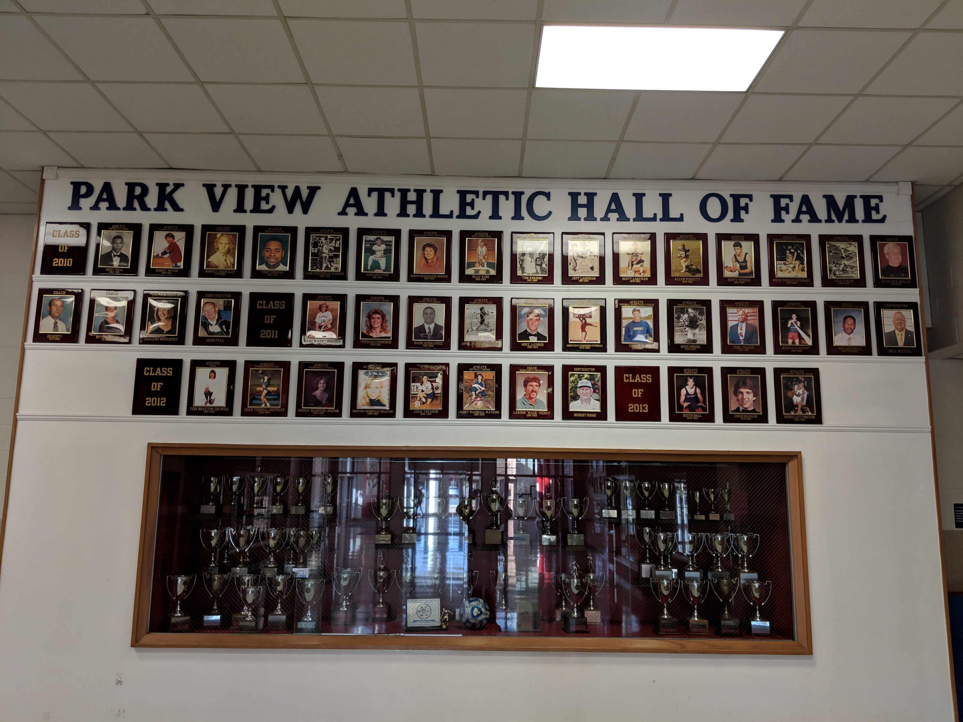
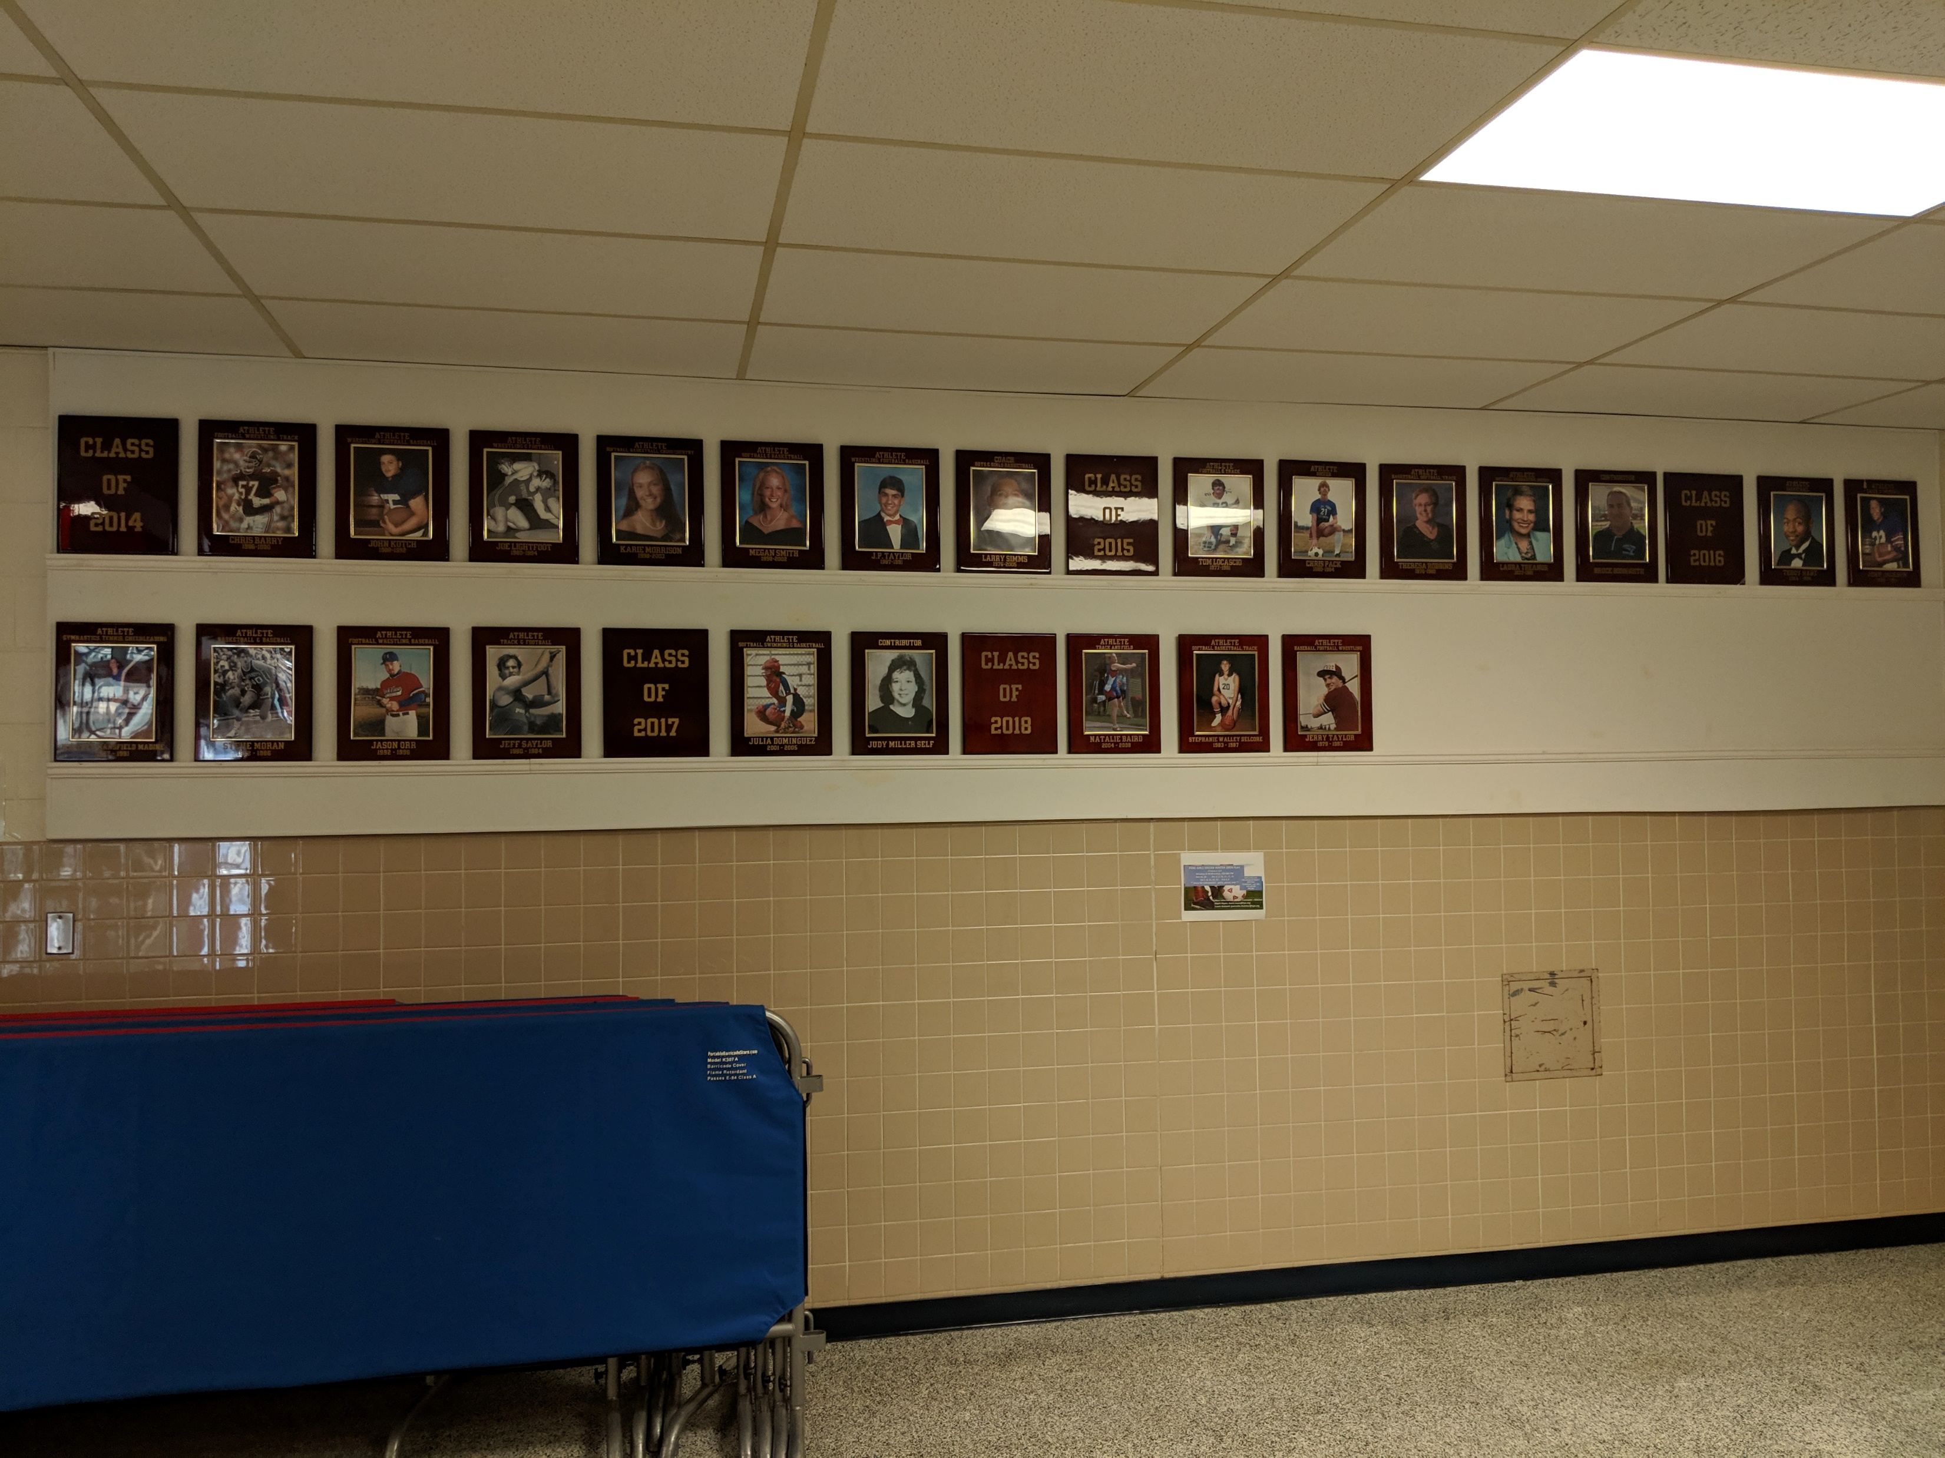
Pictures

Slide 22
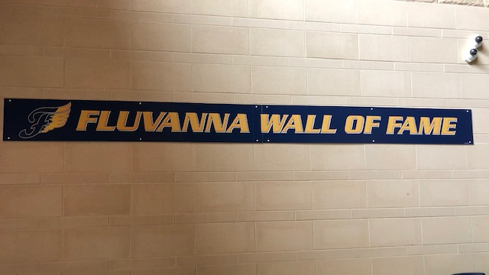
Pictures

Slide 23
Potential Challenges
Depending the age of your school – you may have years to catch up and with an older school it can be extremely difficult to track down info, data and people.
Where in the school do you display the plaque or how you are going to recognize the HOF Inductees?
  Keep in mind – you need room for expansion
Cost – ceremony, display items, gifts for Inductees, publicity, programs, etc….
Continued Interest/help in the future
  Everyone is all in at first, but keeping them involved can be difficult

